Slide 1

Improving Text Extraction Accuracy with Image Preprocessing
Under the guidance of Dr. T. Sridevi
BE2102-07
1601 18 733 067
1601 18 733 081

Slide 2
Agenda
Problem Statement
Methodology
Project Status
Literature Survey
References

Slide 3
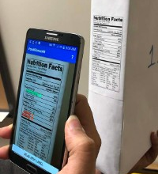
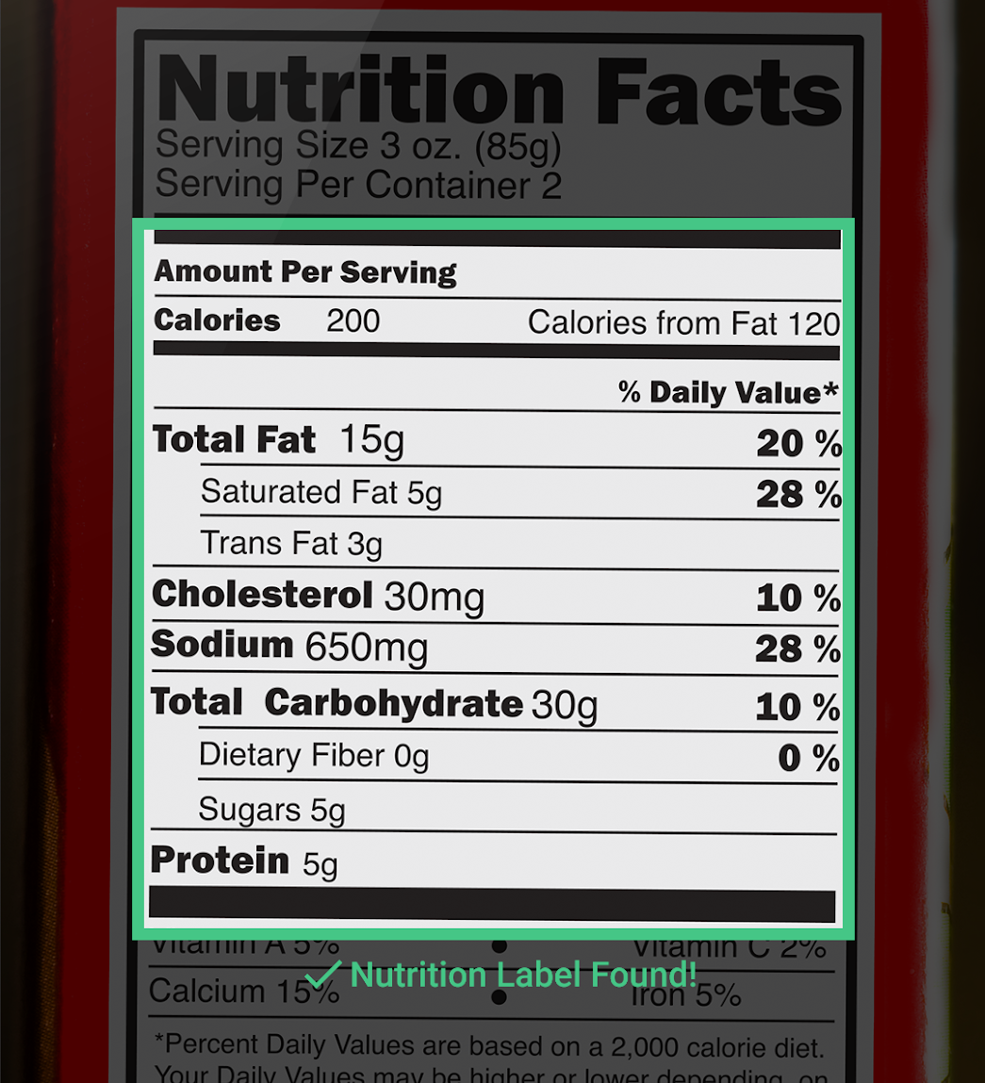
Advancements in computer vision have paved the way by providing tools for text detection and extraction. It’s been observed that the accuracy of the extracted text is relatively low and contains a lot of noise. The aim is to extend the current pipeline to improve the accuracy by
Improving the quality of the image
Using NLP to extract information from raw text

Slide 4
Methodology

Slide 5










Scanned Image File Upload
Image Preprocessing Pipeline
Optical Character Recognition
Text Extraction
Information Extraction
Text - to - Speech Conversion
Document
Scan
API Deployment
Notes:
Preprocessing pipeline workflow
Speech to text

Slide 6
Project Status

Slide 7
Finalized Problem Statement
Gathered research papers related to Text Extraction and brainstormed ideas to find a solution
Preparing for Review 1
Narrowed down the base research papers, proofread abstract with supervisor and prepared for Review-1 presentation
Analysis of Current Approach
Explored tools and techniques for text-to-speech conversion, and gathered research papers on various information extraction procedures
Review 2 Presentation
Present Literature Survey and proposed Solution to Faculty Coordinators. Finalized project workflow.
Week 2
Week 4
Week 6
Week 1
Week 3
Week 5
Week 7
Project Abstract
Outlined the problem statement and the motivation behind choosing the project
Review 1
Present‌ed ‌Abstract ‌and‌ ‌Base‌ ‌Papers‌ ‌to‌ ‌Faculty‌ ‌Coordinators‌ and received‌ ‌Feedback‌ ‌to extend ‌the‌ ‌idea‌ ‌to‌ ‌implement ‌elements‌ ‌such‌ ‌as‌ ‌Text-to-Speech‌ conversion‌
Conducted Literature Survey
Analysed different approaches to information extraction and scrutinised existing approaches to problem statement.

Slide 8
Current Status
Presented Abstract Paper
Conducted literature survey
Analysed various technical approaches that were previously followed to implement text extraction
Prepared and presented a project workflow
Reflected on supervisor feedback and included Information Extraction using Natural Language Processing and Text-to-Speech conversion

Slide 9
Next Steps
Revise and discuss project workflow with supervisor
Determine tools and technologies required to fulfill the project implementation
Define detailed architecture models for the project
Code development and testing
Result analysis

Slide 10
Literature Review

Slide 11
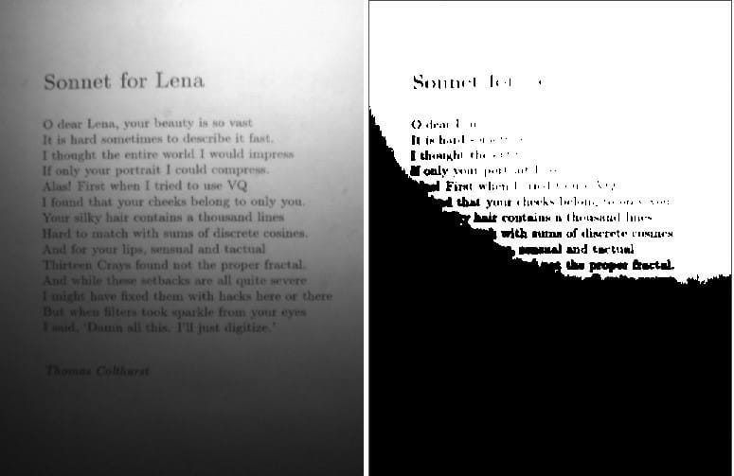
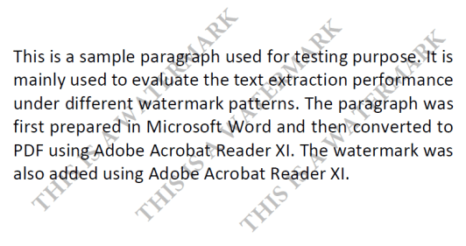
Yang Zhang and Hao Zhang HaoranLi [1] described in their paper, an information extraction pipeline used for event flyers.
Pros: The paper lists several situations where a raw image could cause inaccurate results. They addressed geometric transformation and edge detection.
Cons: They haven’t considered images that are blur or have low brightness
Rishabh Mittal and Anchal Garg [2] introduced and explained the concept of OCR and the process of text extraction.
Pros: Clarified that the process of extraction takes majorly six steps: image acquisition, pre-processing, segmentation, feature extraction, classification, and post-processing.
Cons: Their image pre-processing pipeline would fail for images containing watermarks and gradient brightness

Slide 12


Sanjeev Kumar, Mahika Sharma, Kritika Handa, Rishika Jaiswal [3] proposed an algorithm to improve ocr accuracy with advanced image preprocessing using machine learning.
Pros: They were successful in eliminating biggest obstacle of the Tesseract - computation time of reading images with the highest character dimensions above 20 pixels.
Cons: Their algorithm does not cover images with uneven brightness, watermarks, or different fonts.
Dan Sporici, Elena Cușnir and Costin-Anton Boiangiu [4] underlined Tesseract 4.0 flaws related to the segmentation step.
Pros: Use adaptive image preprocessing where a reinforcement learning model adjusts samples to maximizing the overall recognition efficiency without requiring external intervention.
Cons: The algorithm can get stuck on kernel configurations which will provide inferior results if not enough exploration is performed.

Slide 13
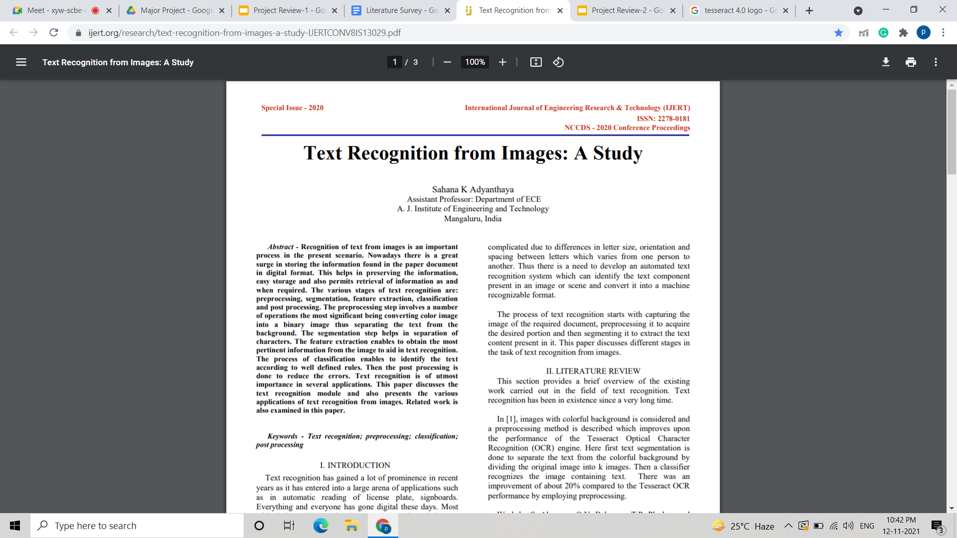
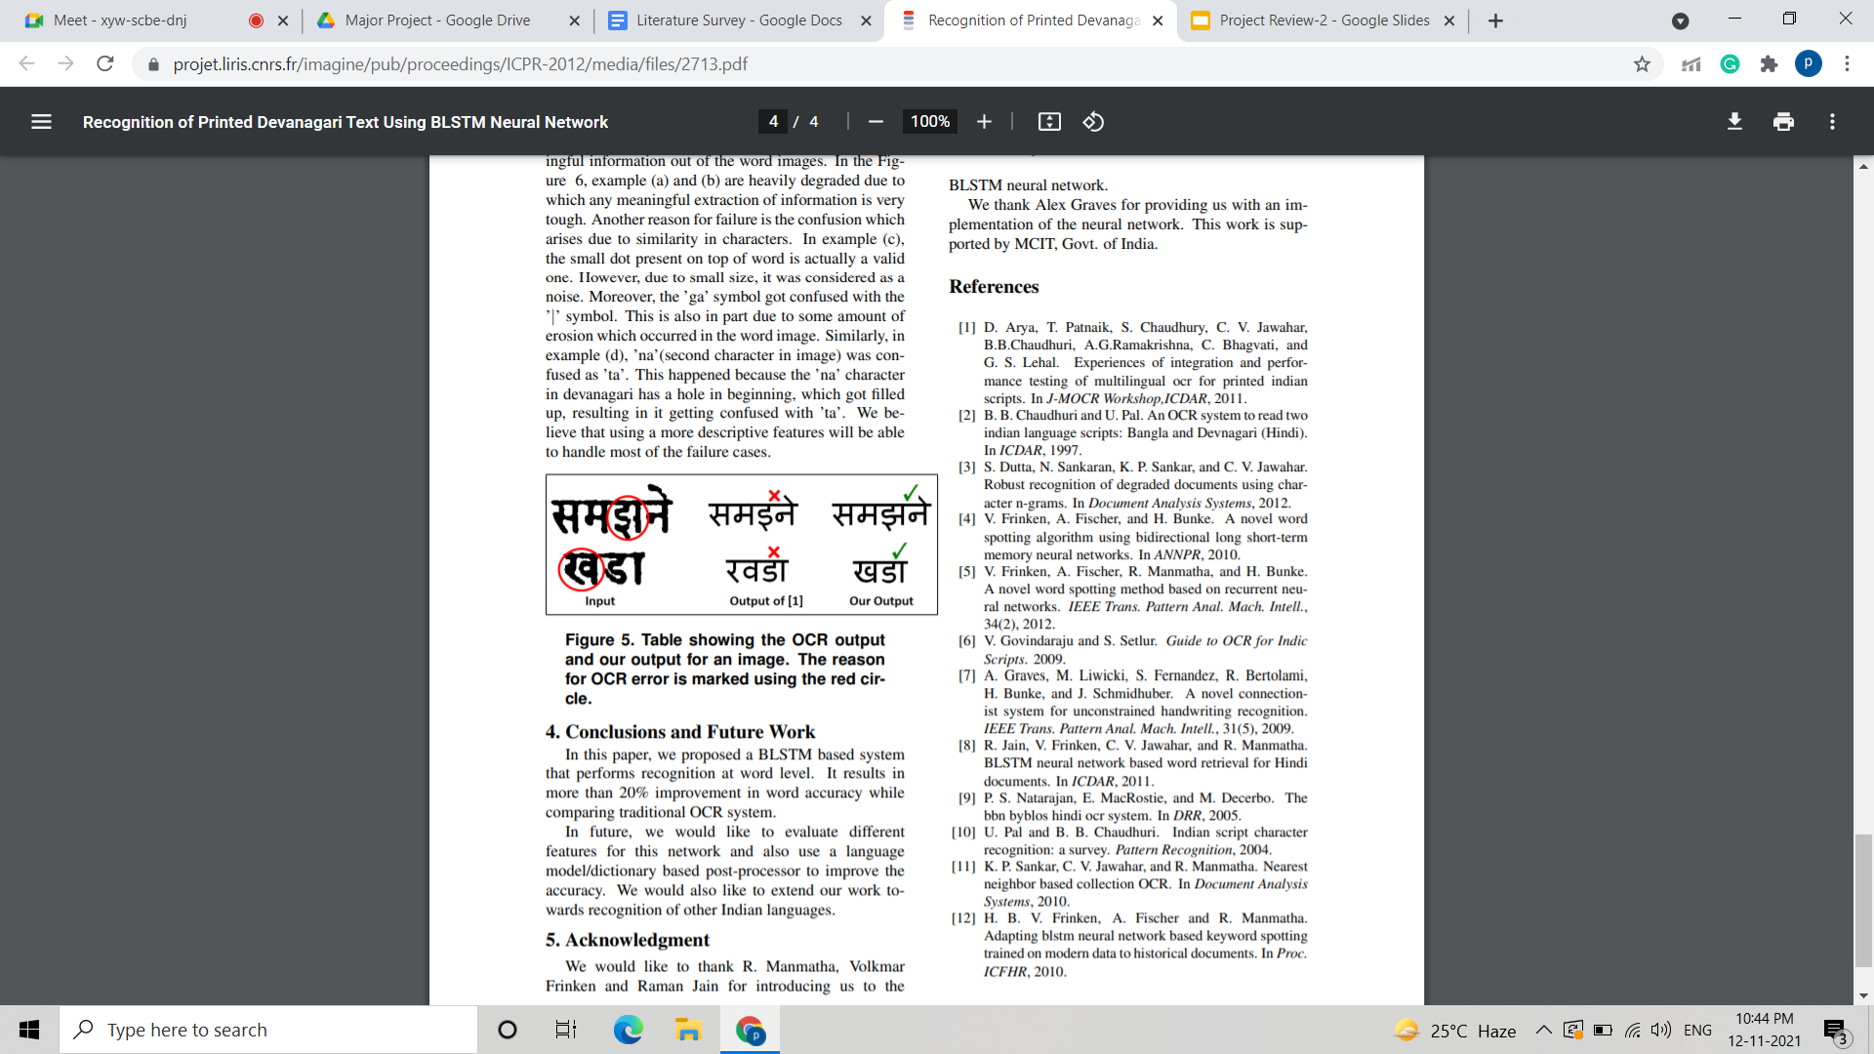
Sahana K Adyanthaya put forward a paper [5] that presents the various steps taken to recognise text from images and highlights that noise present in an image plays a major role in text recognition.
Pros: Learn that Gaussian filter and mean filter can be used for noise removal, normalization to ensure uniformity, followed by binarization to convert gray images into binary image.
Cons: Other pre-processing steps are also required prior to noise removal, as well as for successful text extraction
Naveen Sankaran and C.V Jawahar [6] proposed a neural network-based framework that operates based on Bidirectional Long Short-Term Memory-allowing OCR to work at word level.
Pros: Leads to over 20% better results and nearly 9% decrease in character error compared to more widely available OCR frameworks
Cons: It uses a method that does not require segmentation, that is one amongst the foremost common reasons for the error.

Slide 14
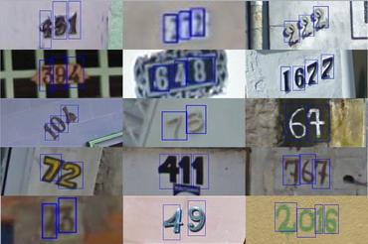
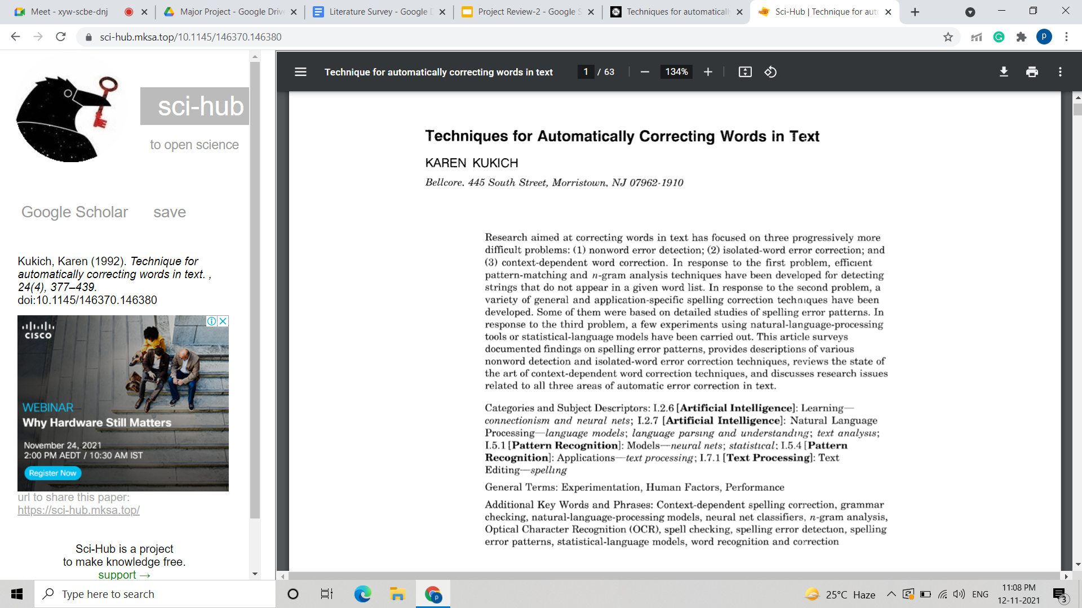
Sai Abhishikth Ayyadevara, P N V Sai Ram Teja, Rajesh Kumar M [7], deals with two different machine learning techniques.
Pros: Analysed two complete different approaches to image preprocessing.
Cons: Their complete focus was on feature extraction
Kukich[1] suggested using a n-gram dictionary or method based on the errors and returning the possible word to the dictionary using mathematical steps.
Cons: These methods may reduce the total number of OCR errors in standard language names, but it is possible that the words may be correctly identified that are not in the dictionary of geographical names.

Slide 15
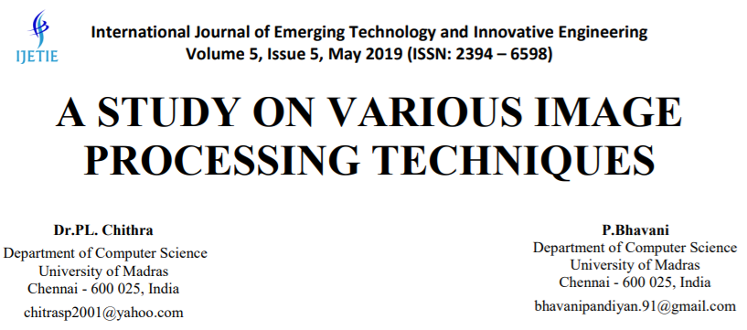
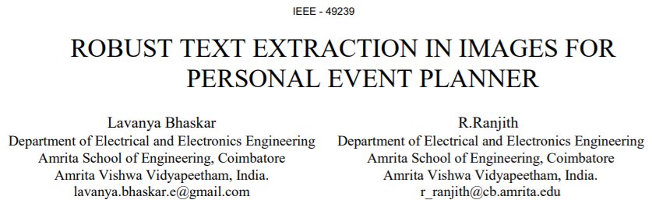
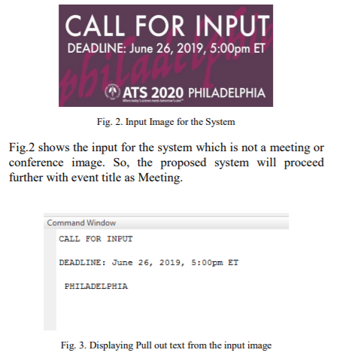
Dr. PL Chitra, and P Bhavani [9], in this paper have studied various images to remove unwanted noise and performed enhancement techniques.
Pros: Techniques such as contrast limited adaptive histogram equalization, Laplacian and Harr filtering, unsharp masking, sharpening, high boost filtering and color models were used.
Lavanya Bhaskar and R Ranjit [10] discuss an event planner for the brochure images, that implements text extraction by convolution followed by MSER feature extraction and Stroke width method.
Pros: The event planner then directly links the event text to the google calendar for scheduling the events.
Cons: However, the algorithm is not tested for event information taken from handwritten images and complex font text present in the images.

Slide 16
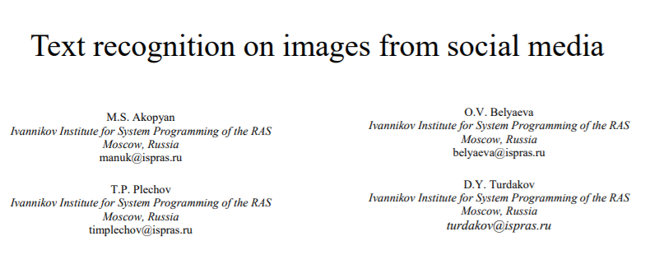
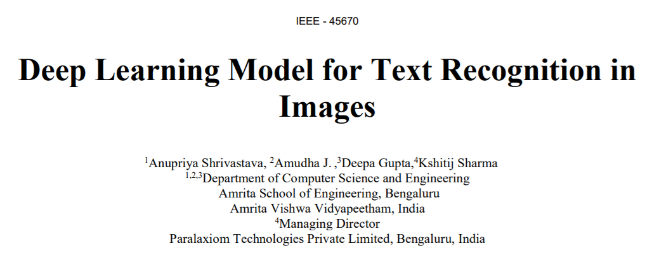
Work by M.S. Akopyan, O.V. Belyaeva, T.P. Plechov and D.Y. Turdakov [11] is based on a text extraction pipeline which is used to extract text from images obtained from social media.
Pros: Their work focused on dividing and preprocessing the input images based on various classes, followed by text recognition using the OCR engine.
Cons: The model works only for digitised images of high quality.
Anupriya Shrivastava, Amudha J.Deepa Gupta and Kshitij Sharma [12] in their work have developed a system based on Convolutional Neural Network and Long Short Term Memory.
Pros: The developed model identifies the texts from images which are horizontal, curved or oriented style.
Cons: The model however fails to identify text from illuminated and blurry images.

Slide 17
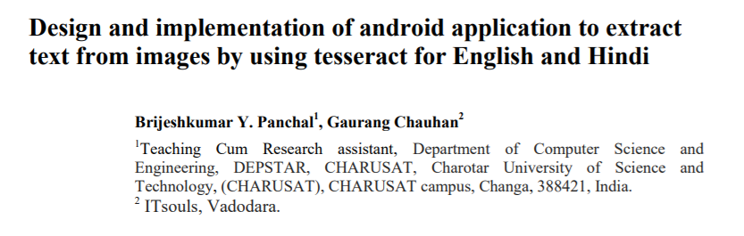
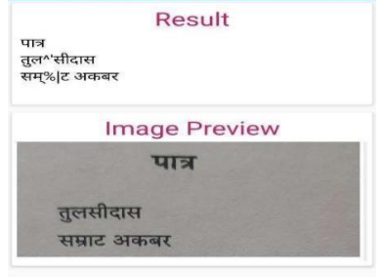
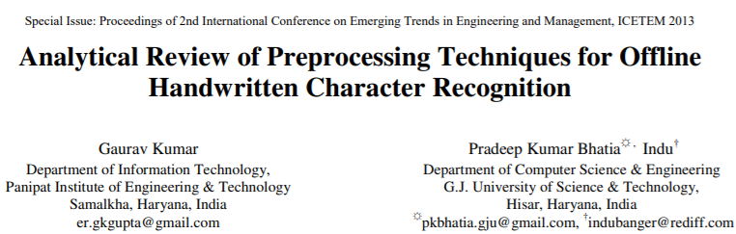
Brijesh Kumar Y. Panchal, and Gaurang Chauhan [13] proposed an implementation through an Android Application to extract using Tesseract OCR.
Pros: The Application generates text which is printed on a clean, B/W or colourful background and then can be converted into a computer readable form ASCII.
Cons: The user has to manually edit the picture for the system to further proceed with text extraction.
K. Gaurav, Bhatia P. K. [14], deals with assorted pre-processing techniques used for handwritten recognition.
Pros: The pre-processing techniques that were included are contrast stretching, noise removal techniques, normalization and segmentation, binarization, morphological processing techniques.
Cons: Even though after applying all the said techniques, the accuracy of the image is not upto the mark.

Slide 18
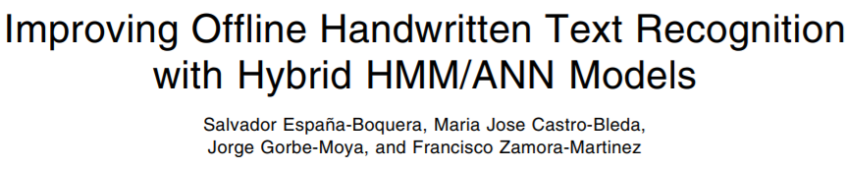
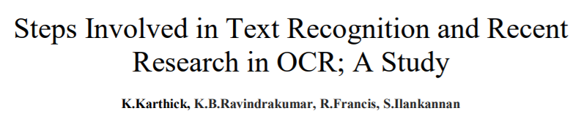
Salvador España-Boquera, Maria J. C. B., Jorge G. M. and Francisco Z. M. [15] outlines the hybrid Hidden Markov Model (HMM) is used to conceive the unconstrained offline handwritten texts.
Pros: The main characteristics of the recognition systems is to produce a new way in the form of preprocessing and recognition which are both based on ANNs.
Cons: The paper focuses on enhancing the non-uniform slant and slope correction only.
K. Karthick, K.B. Ravindrakumar, R. Francis and S.Ilankannan [16] have discussed the various steps and techniques used for text detection.
Pros: From their study it has been found that best results come from reduced computation time and it is possible to segment multilingual characters and enhance character recognition rate.

Slide 19
References
[1] K. Karthick, K.B. Ravindrakumar, R. Francis, S. Ilankannan, “Steps Involved in Text Recognition and Recent Research in OCR; A Study”, International Journal of Recent Technology and Engineering (IJRTE) ISSN: 2277-3878, Volume-8, Issue-1, May 2019.
[2] Mittal, Rishabh; Garg, Anchal, “Text extraction using OCR: A Systematic Review”, 2020 Second International Conference on Inventive Research in Computing Applications (ICIRCA), 2020, pp 357–362.
[3] Sanjeev Kumar, Mahika Sharma, Kritika Handa, Rishika Jaiswal, “Improve OCR Accuracy with Advanced Image Preprocessing using Machine Learning with Python”, International Journal of Innovative Technology and Exploring Engineering (IJITEE) ISSN: 2278-3075, Volume-9 Issue-7, May 2020.
[4] Dan Sporici, Elena Cușnir and Costin-Anton Boiangiu, “Improving the Accuracy of Tesseract 4.0 OCR Engine Using Convolution-Based Preprocessing”, International Journal of Innovative Technology and Exploring Engineering, Volume-12 Issue-5, May 2, 2020.

Slide 20
References
[5] Sahana K Adyanthaya, “Text Recognition from Images: A Study”, International Journal of Engineering Research & Technology (IJERT), ISSN: 2278-0181, Volume-8 Issue-13, 2020.
[6] Naveen Sankaran and C.V Jawahar, “Recognition of Printed Devanagari Text Using BLSTM Neural Network”, 21st International Conference on Pattern Recognition (ICPR), November 11-15, 2012. Tsukuba, Japan.
[7] Sai Abhishikth Ayyadevara, P N V Sai Ram Teja, Bharath K P Rajesh Kumar M, “Handwritten Character Recognition Using Unique Feature Extraction Technique”, International Research Journal of Modernization in Engineering Technology and Science, Volume-3 Issue-10, Jan 2020.
[8] Karen Kukich, “System that automatically converts word into text”, ACM Computing Surveys, Vol. 24, No. 4, December 1992.

Slide 21
References
[9] Dr. PL Chithra, P Bhavani, P. , “A Study on Various Image Processing Techniques”, International Journal of Emerging Technology and Innovative Engineering (ISSN (print): 2394 – 6598) Volume 5, Issue 5, May 2019.
[10] Bhaskar, L., & Ranjith, R. , “Robust Text Extraction in Images for Personal Event Planner”,. 2020 11th International Conference on Computing, Communication and Networking Technologies (ICCCNT) July 1-3, 2020, IIT-Kharagpur, Kharagpur, India.
[11] M.S. Akopyan, O.V. Belyaeva, T.P. Plechov and D.Y. Turdakov, “Text recognition on images from social media”, Ivannikov Memorial Workshop (IVMEM), 2019.
[12] Anupriya Shrivastava, Amudha J., Deepa Gupta, Kshitij Sharma, “Deep Learning Model for Text Recognition in Images”, 10th ICCCNT 2019 July 6-8, 2019, IIT - Kanpur, Kanpur, India.

Slide 22
References
[13] Brijeshkumar Y. Panchal and Gaurang Chauhan, “Design and implementation of android application to extract text from images by using tesseract for English and Hindi”, 3rd International Scientific Conference of Engineering Sciences and Advances Technologies (IICESAT), Journal of Physics: Conference Series, Volume 1973, 4-5 June, 2021.
[14] K. Gaurav and Bhatia P. K., “Analytical Review of Preprocessing Techniques for Offline Handwritten Character Recognition”, 2nd International Conference on Emerging Trends in Engineering & Management, ICETEM, 2013.
[15] Salvador España-Boquera, Maria J. C. B., Jorge G. M. and Francisco Z. M., “Improving Offline Handwritten Text Recognition with Hybrid HMM/ANN Models”, IEEE Transactions on Pattern Analysis and Machine Intelligence, Vol. 33, No. 4, April 2011.
[16] Yang Zhang, Hao Zhang, HaoranLi, “Event Info Extraction from Flyers”, 2021.

Slide 23
Thank You

